Slide 1
Employee Attrition Prediction

Slide 2
Team Information
Sravani Lankala (700746285)
Krishna Vamsi Koppula (700745021)
Sudhakumari Kothapalli (700744316)

Slide 3
Role/Responsibilities and Contribution in project
Team Member | Roles and Responsibilities
Sravani Lankala (700746285) | Data Collection, Data cleaning, preparation(Collecting employee details and updating dataset) and implementation
Krishna Vamsi Koppula (700745021) | Exploratory Data Analysis(EDA), Feature Selection and implementation
Sudhakumari Kothapalli (700744316) | Model Evaluation(Building Machine Learning models) and implementation

Slide 4
Motivation
The motivation behind the employee attrition prediction project is to address the challenges faced by organizations in managing their workforce, reducing costs, and retaining highly valued employees.
Employee attrition can have significant financial implications for organizations, as it takes time and resources to replace employees and bring new hires up to maximum productivity.

Slide 5
Objectives
Exploratory Data Analysis (EDA)
Data Gathering
Preparation of raw data
Build ensemble Machine Learning algorithms
Deploy model into Web Application
Report generation for high-risk employees

Slide 6
Related work
Tree Based Ensemble Methods : A tree-based ensemble technique and statistical models for identifying the important elements that influence employee attrition in the workplace
Data Mining Techniques : Forecast employee opinions and satisfaction according to the surveys. In this research, it is recommended that employee input from periodic surveys be subjected to data mining and sentiment analysis. This reflects the degree of overall employee happiness inside the business.
Machine Learning algorithms: Support Vector Machine, Decision Tree, K-Nearest Neighbour, Random Forest, and Naive Bayes algorithms are employed in the Python environment to categorize the employee as staying or leaving

Slide 7
Problem Statement
Retirement or leaving the company are examples of employee attrition. In terms of revenue planning and other financial considerations, employee attrition is crucial. Though organizations can replace employees, the typical duration to fill a post is 42 days, and it typically takes 6 to 8 months to reach maximum productivity. To a certain extent employees leaving the organization is normal but losing highly valued employees is a risk factor. Several factors trigger employee departure, retirement, career growth, and dissatisfaction at the workplace. Analysing these parameters manually becomes a tedious task.

Slide 8
Proposed Solution
In this paper we are proposing an ensemble of machine learning algorithms and tree based machine learning algorithms to classify the employees into staying and or exiting. The results of the ensemble algorithms are compared with the non tree based algorithms
To the existing dataset additional features are added like reason for leaving the previous company, previous work experience, salary hike expectation, promotion factors.
We are proposing a feature selection method to find the most important causes to the attrition of the employee using various statistical methods and comparative analysis of the traditional machine learning models with the tree based ensemble models. For the experimental analysis IBM HR Analytics Employee Attrition & Performance dataset is used from Kaggle.
To improve the accuracy of the model compared to the existing methods we have proposed iterative approaches like cross validation and hyper parameters tuning.

Slide 9
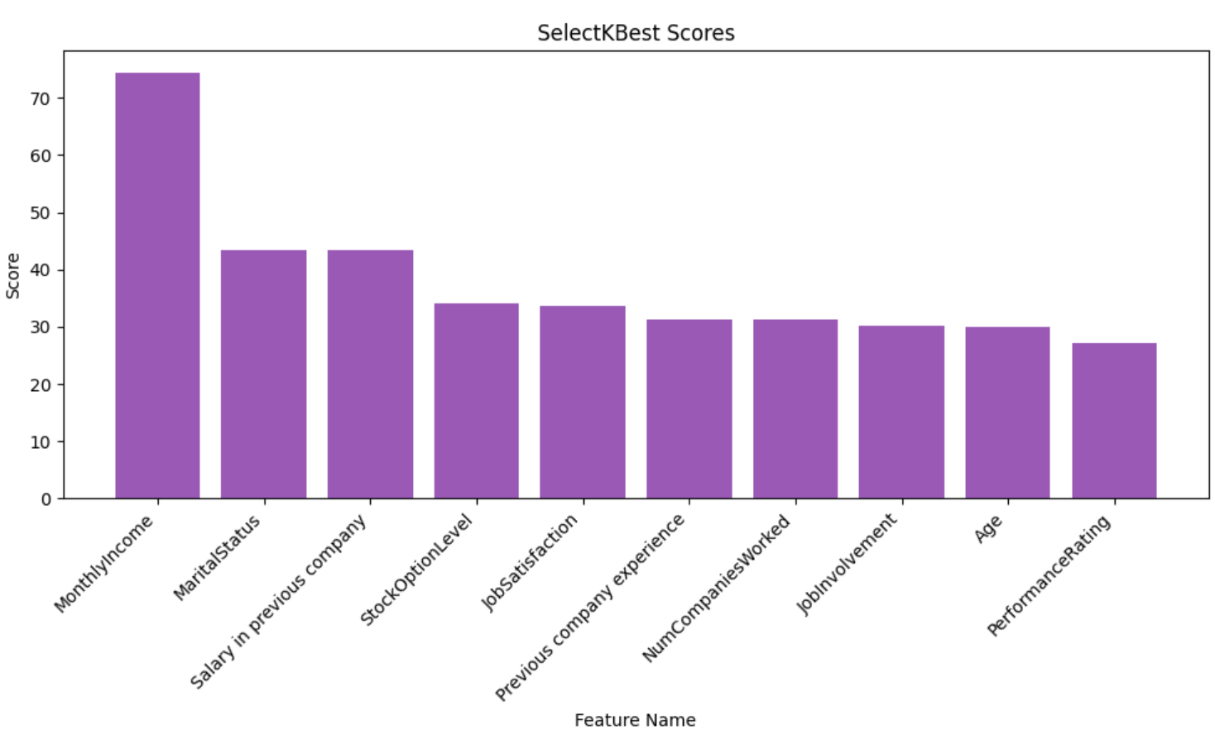
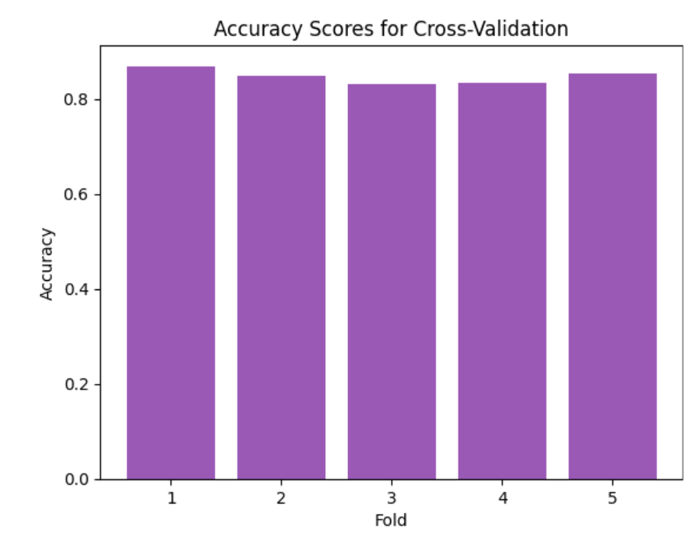
Results/Simulations
Fig1: Feature selection scores
Fig2: Cross validation scores

Slide 10
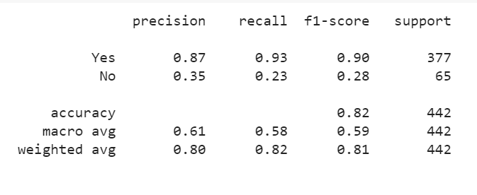
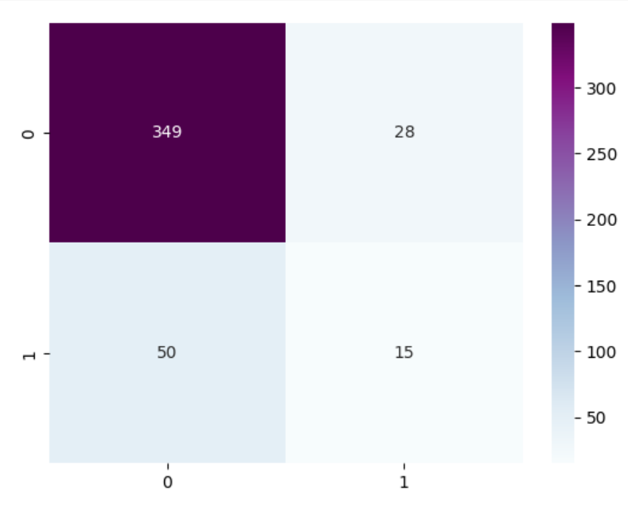
Fig3: Classification report of Gradient boosting classifier
Fig4: Classification report of AdaBoost classifier
Fig5: Confusion matrix of gradient boosting classifier
Fig6: Confusion matrix of AdaBoost classifier

Slide 11
References
[1].V. Mehta and S. Modi, "Employee Attrition System Using Tree Based Ensemble Method," 2021 2nd International Conference on Communication, Computing and Industry 4.0 (C2I4), Bangalore, India, 2021, pp. 1-4, doi: 10.1109/C2I454156.2021.9689398.
[2].S. Yadav, A. Jain and D. Singh, "Early Prediction of Employee Attrition using Data Mining Techniques," 2018 IEEE 8th International Advance Computing Conference (IACC), Greater Noida, India, 2018, pp. 349-354, doi: 10.1109/IADCC.2018.8692137.
[3].S. S. Alduayj and K. Rajpoot, "Predicting Employee Attrition using Machine Learning," 2018 International Conference on Innovations in Information Technology (IIT), Al Ain, United Arab Emirates, 2018, pp. 93-98, doi: 10.1109/INNOVATIONS.2018.8605976.
[4].M. Naseem, K. Chaudhary, B. Sharma and A. G. Lal, "Using Ensemble Decision Tree Model to Predict Student Dropout in Computing Science," 2019 IEEE Asia-Pacific Conference on Computer Science and Data Engineering (CSDE), Melbourne, VIC, Australia, 2019, pp. 1-8, doi: 10.1109/CSDE48274.2019.9162389.

